Slide 1
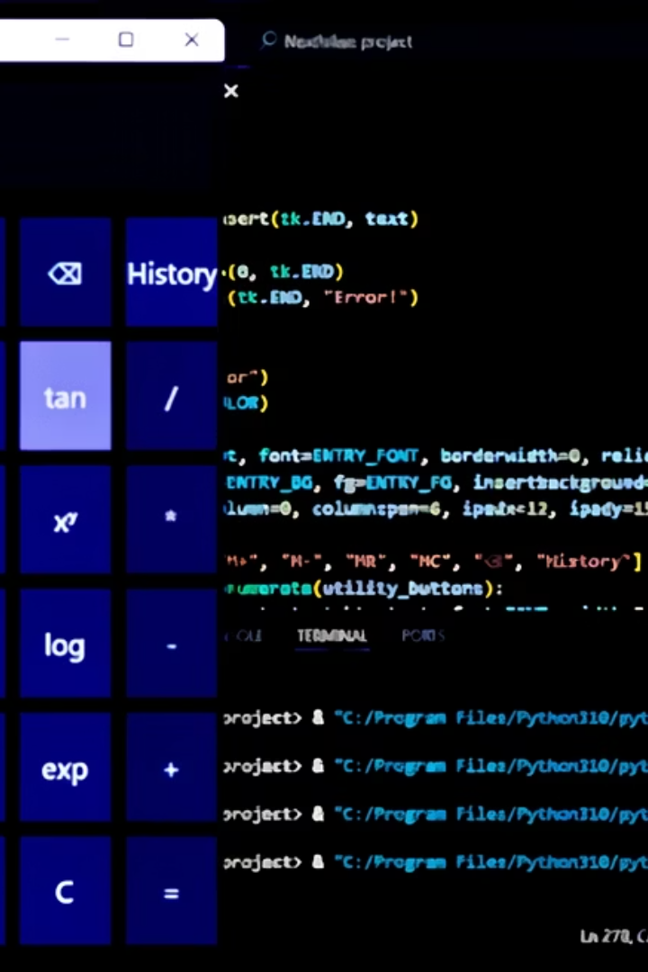
Calculator Project
by Shivangi Chaudhary
Organization- Nexthikes IT Solutions.

Slide 2

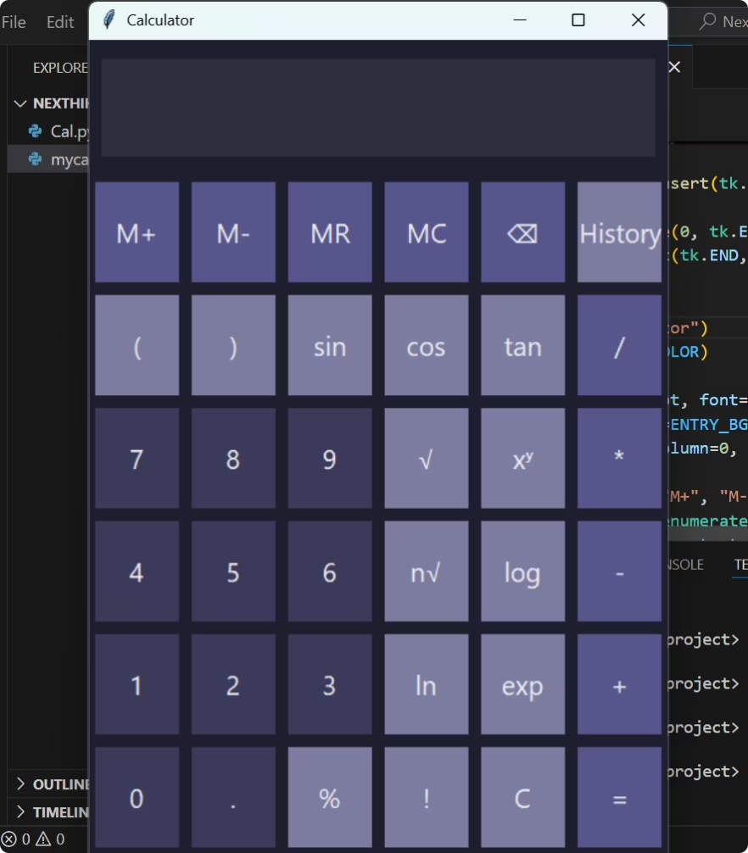
Calculator Features & Uniqueness
Advanced Functions
Memory Operations
Supports roots, exponents, logs, trigonometry
Memory add, subtract, recall, clear
Input Validation
Limits input length, error handling
(Adding a screenshot of the calculator made by me.)

Slide 3



Libraries Used
tkinter
GUI creation and event handling
math
Mathematical functions and constants
re
Expression preprocessing with regex
Each library enables core calculator functionality and UI.
tkinter was chosen due to its simplicity, lightweight nature, and wide availability in standard Python installations, making development and deployment more straightforward.
Guided by our mentor's insight, I immersed myself in exploring the tkinter library.

Slide 4
Challenges Faced & How I Overcame Them
Designing the Interface-Initially, the calculator looked very basic. I struggled with making the UI attractive. After researching online and watching YouTube tutorials, I learned to use padding and borders to improve button visibility and layout.
Implementing Advanced Features- Basic operations were simple, but adding advanced features like keyboard input, square root, percentage, and dark mode was challenging due to complex logic. I overcame this by studying examples, watching tutorial videos, and breaking the problems into smaller parts.
Debugging Errors- I often ran into coding errors I didn’t understand. I watched youtube videos for that particular code type and used Google for explanations and corrections, which helped me fix bugs and learn better coding practices.
Have attached the references in the next slide.

Slide 5
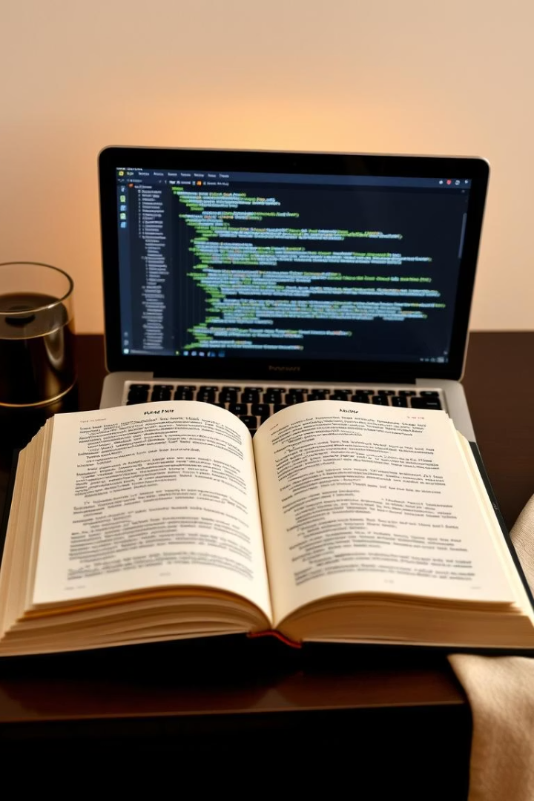
References
https://dev.to/spiff/calculator-with-gui-using-python-tkinter-jpn
https://www.geeksforgeeks.org/python-gui-tkinter/
https://www.youtube.com/watch?v=fbxsYcSccJE&list=PLu0W_9lII9ajLcqRcj4PoEihkukF_OTzA&index=28
https://codewithcurious.com/projects/scientific-calculator-using-python/
https://www.youtube.com/watch?v=c6gjhWvj2l0
https://www.youtube.com/playlist?list=PLCC34OHNcOtoC6GglhF3ncJ5rLwQrLGnV

Slide 6

Thank You
Appreciate your time and attention
Questions and feedback welcome

